Slide 1


Ethics and Chat GPT
Introduction to Machine Learning – Lecture 3. Balázs Nagy, PhD

Slide 2
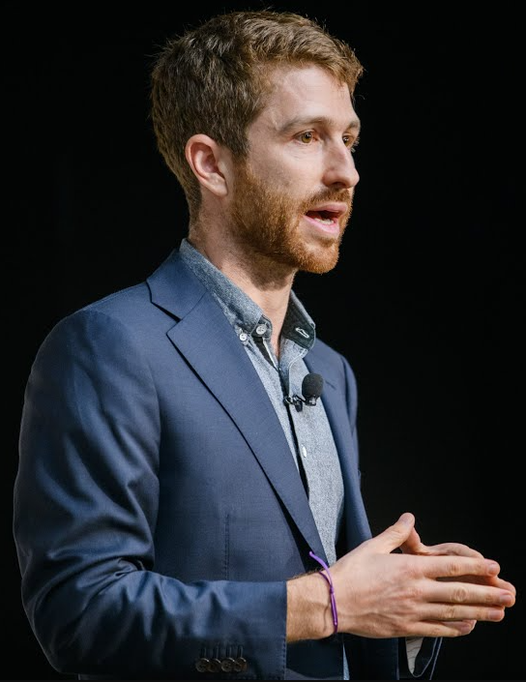
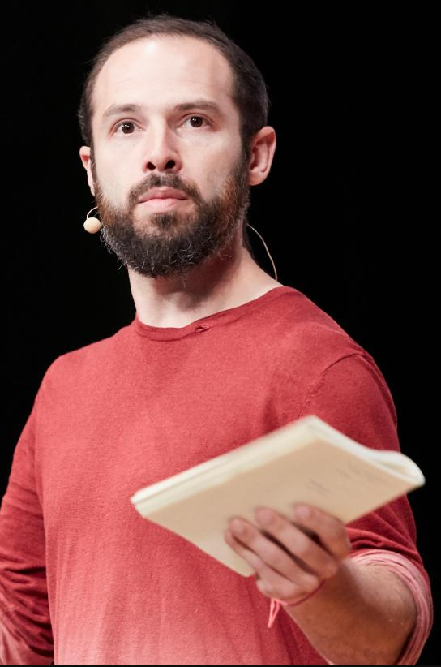

Mindset
Tristan
Harris
Aza Raskin
Our mission is to shift technology towards a more humane future that supports our well-being, democratic functioning, and shared information environment.
Notes:
Rubber band effect
Tristan Harris - technology ethicist - executive director and co-founder of the Center for Humane Technology
Aza Raskin
- co-founder of the Center for Humane Technology

Slide 3
The AI dilemma
References:
The AI dilemma speech
https://www.youtube.com/watch?v=cB0_-qKbal4&t=1163s
https://www.youtube.com/watch?v=xoVJKj8lcNQ&t=203s
Video
https://www.youtube.com/watch?v=uG8vItscFKc
Notes:
It is not stealing if you reference it properly.
BORROWED material

Slide 4


Slide 5
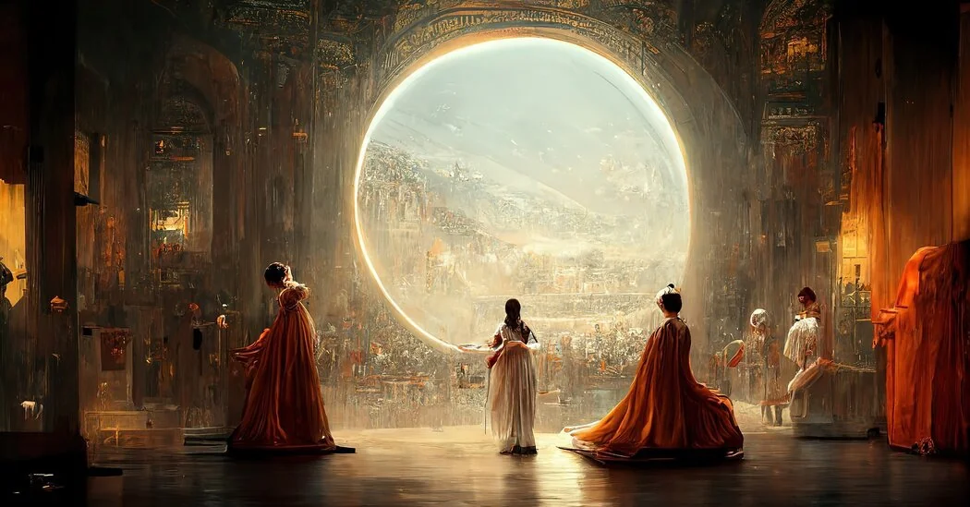
Théâtre D'opéra Spatial - Allen Jason

Slide 6
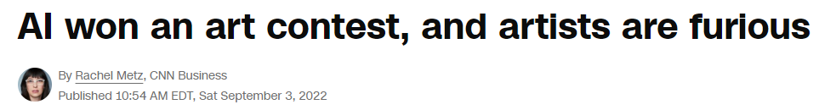
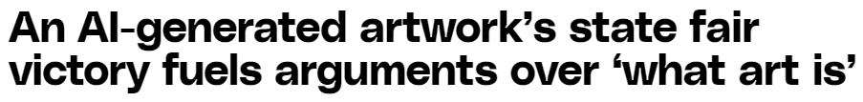
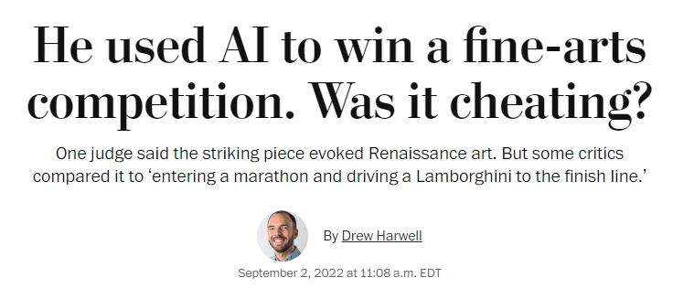
How do we treat AI?
How do we treat AI?
AI taking over our jobs?
Tool or Competition?

Slide 7

Two sides
Helping
Tool
Fierce
Rival
OR
„We can achieve great things with it.”
„AI take our jobs.”
Notes:
A painter can use a brush to create a picture.
A digital artist use a generative model to create an image.
What is the difference? Is there any?
Prompt engineering.

Slide 8
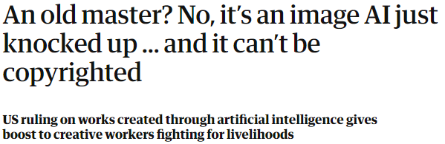
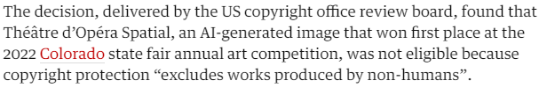
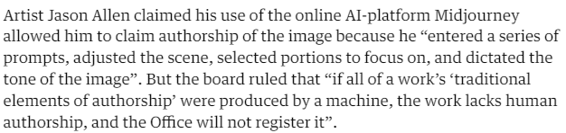
Closure?
https://www.theguardian.com/technology/2023/sep/24/an-old-master-no-its-an-image-ai-just-knocked-up-and-it-cant-be-copyrighted?fbclid=IwAR0XaFtPaDvqG-IsjVal_XuxjR5qXiRN_hIHreusy2LTL_kqtizwGlg24-Q

Slide 9

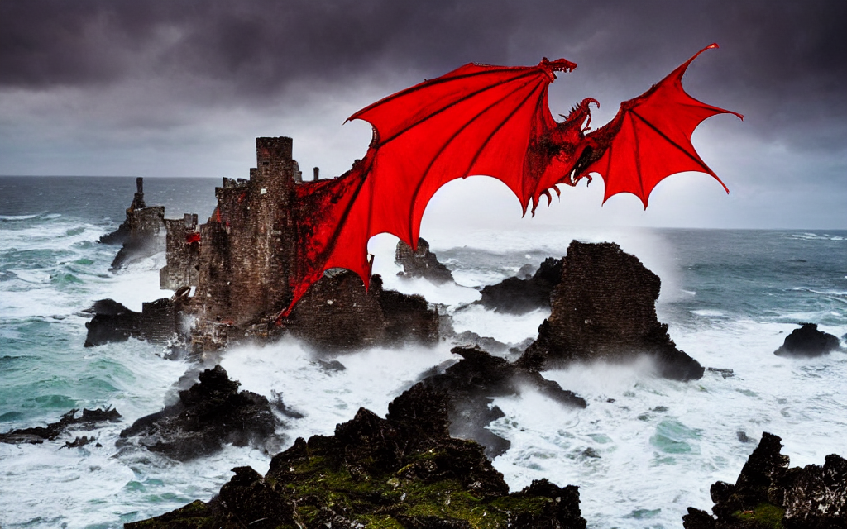
Attempt #1
Prompt: A big red fire breathing dragon flying over a ruined castle on a cliff overlooking the sea, with a stormy sky and crashing waves, eerie, moody, atmospheric Software: SD online Iteration: 2

Slide 10
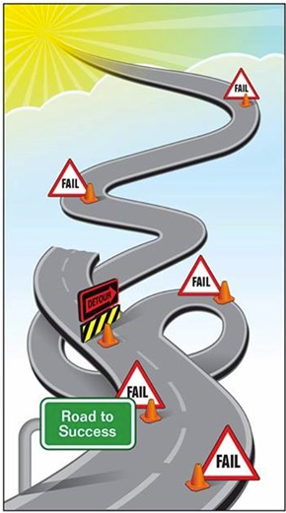
Road to success

Slide 11
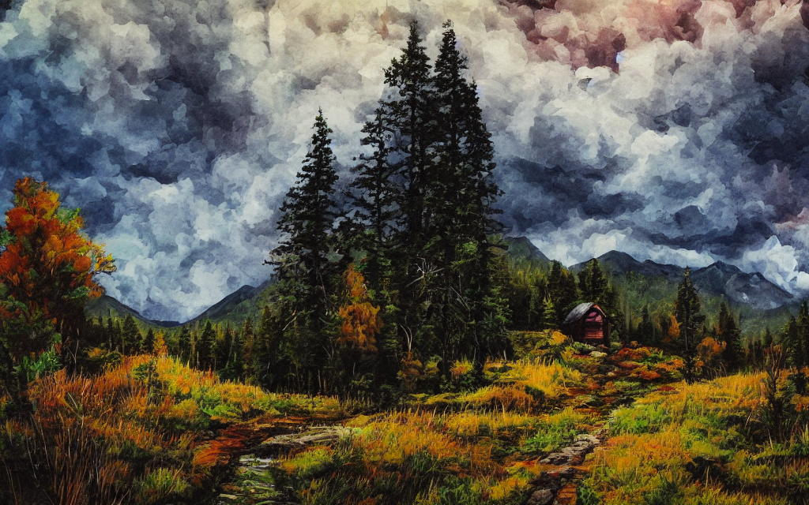

Attempt # many
Prompt: Acrylic painting of a mountain landscape, with a stormy sky and a cabin nestled in the forest, high contrast, high resolution Software: SD offline Iteration: 40 Batch: 4

Slide 12
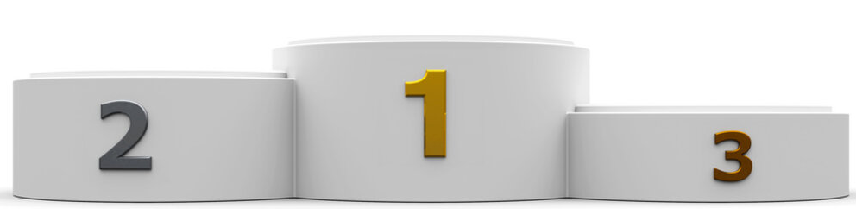
Optional Homework #1 (10 points)
Generative Art Competition
Generate a picture with a generative AI
Topic:
„Majestic creature”
Document the used software or application and the steps that lead to the final image
Include the used prompt
Option 1: Dall-E https://openai.com/dall-e-2
Option 2: Stable Diffusion XL online https://clipdrop.co/stable-diffusion
Option 3: Stable Diffusion XL offline https://github.com/AbdBarho/stable-diffusion-webui-docker
Option 4: Midjourney
Option 5: Any other Generative model
10 p
9 p
8 p

Slide 13
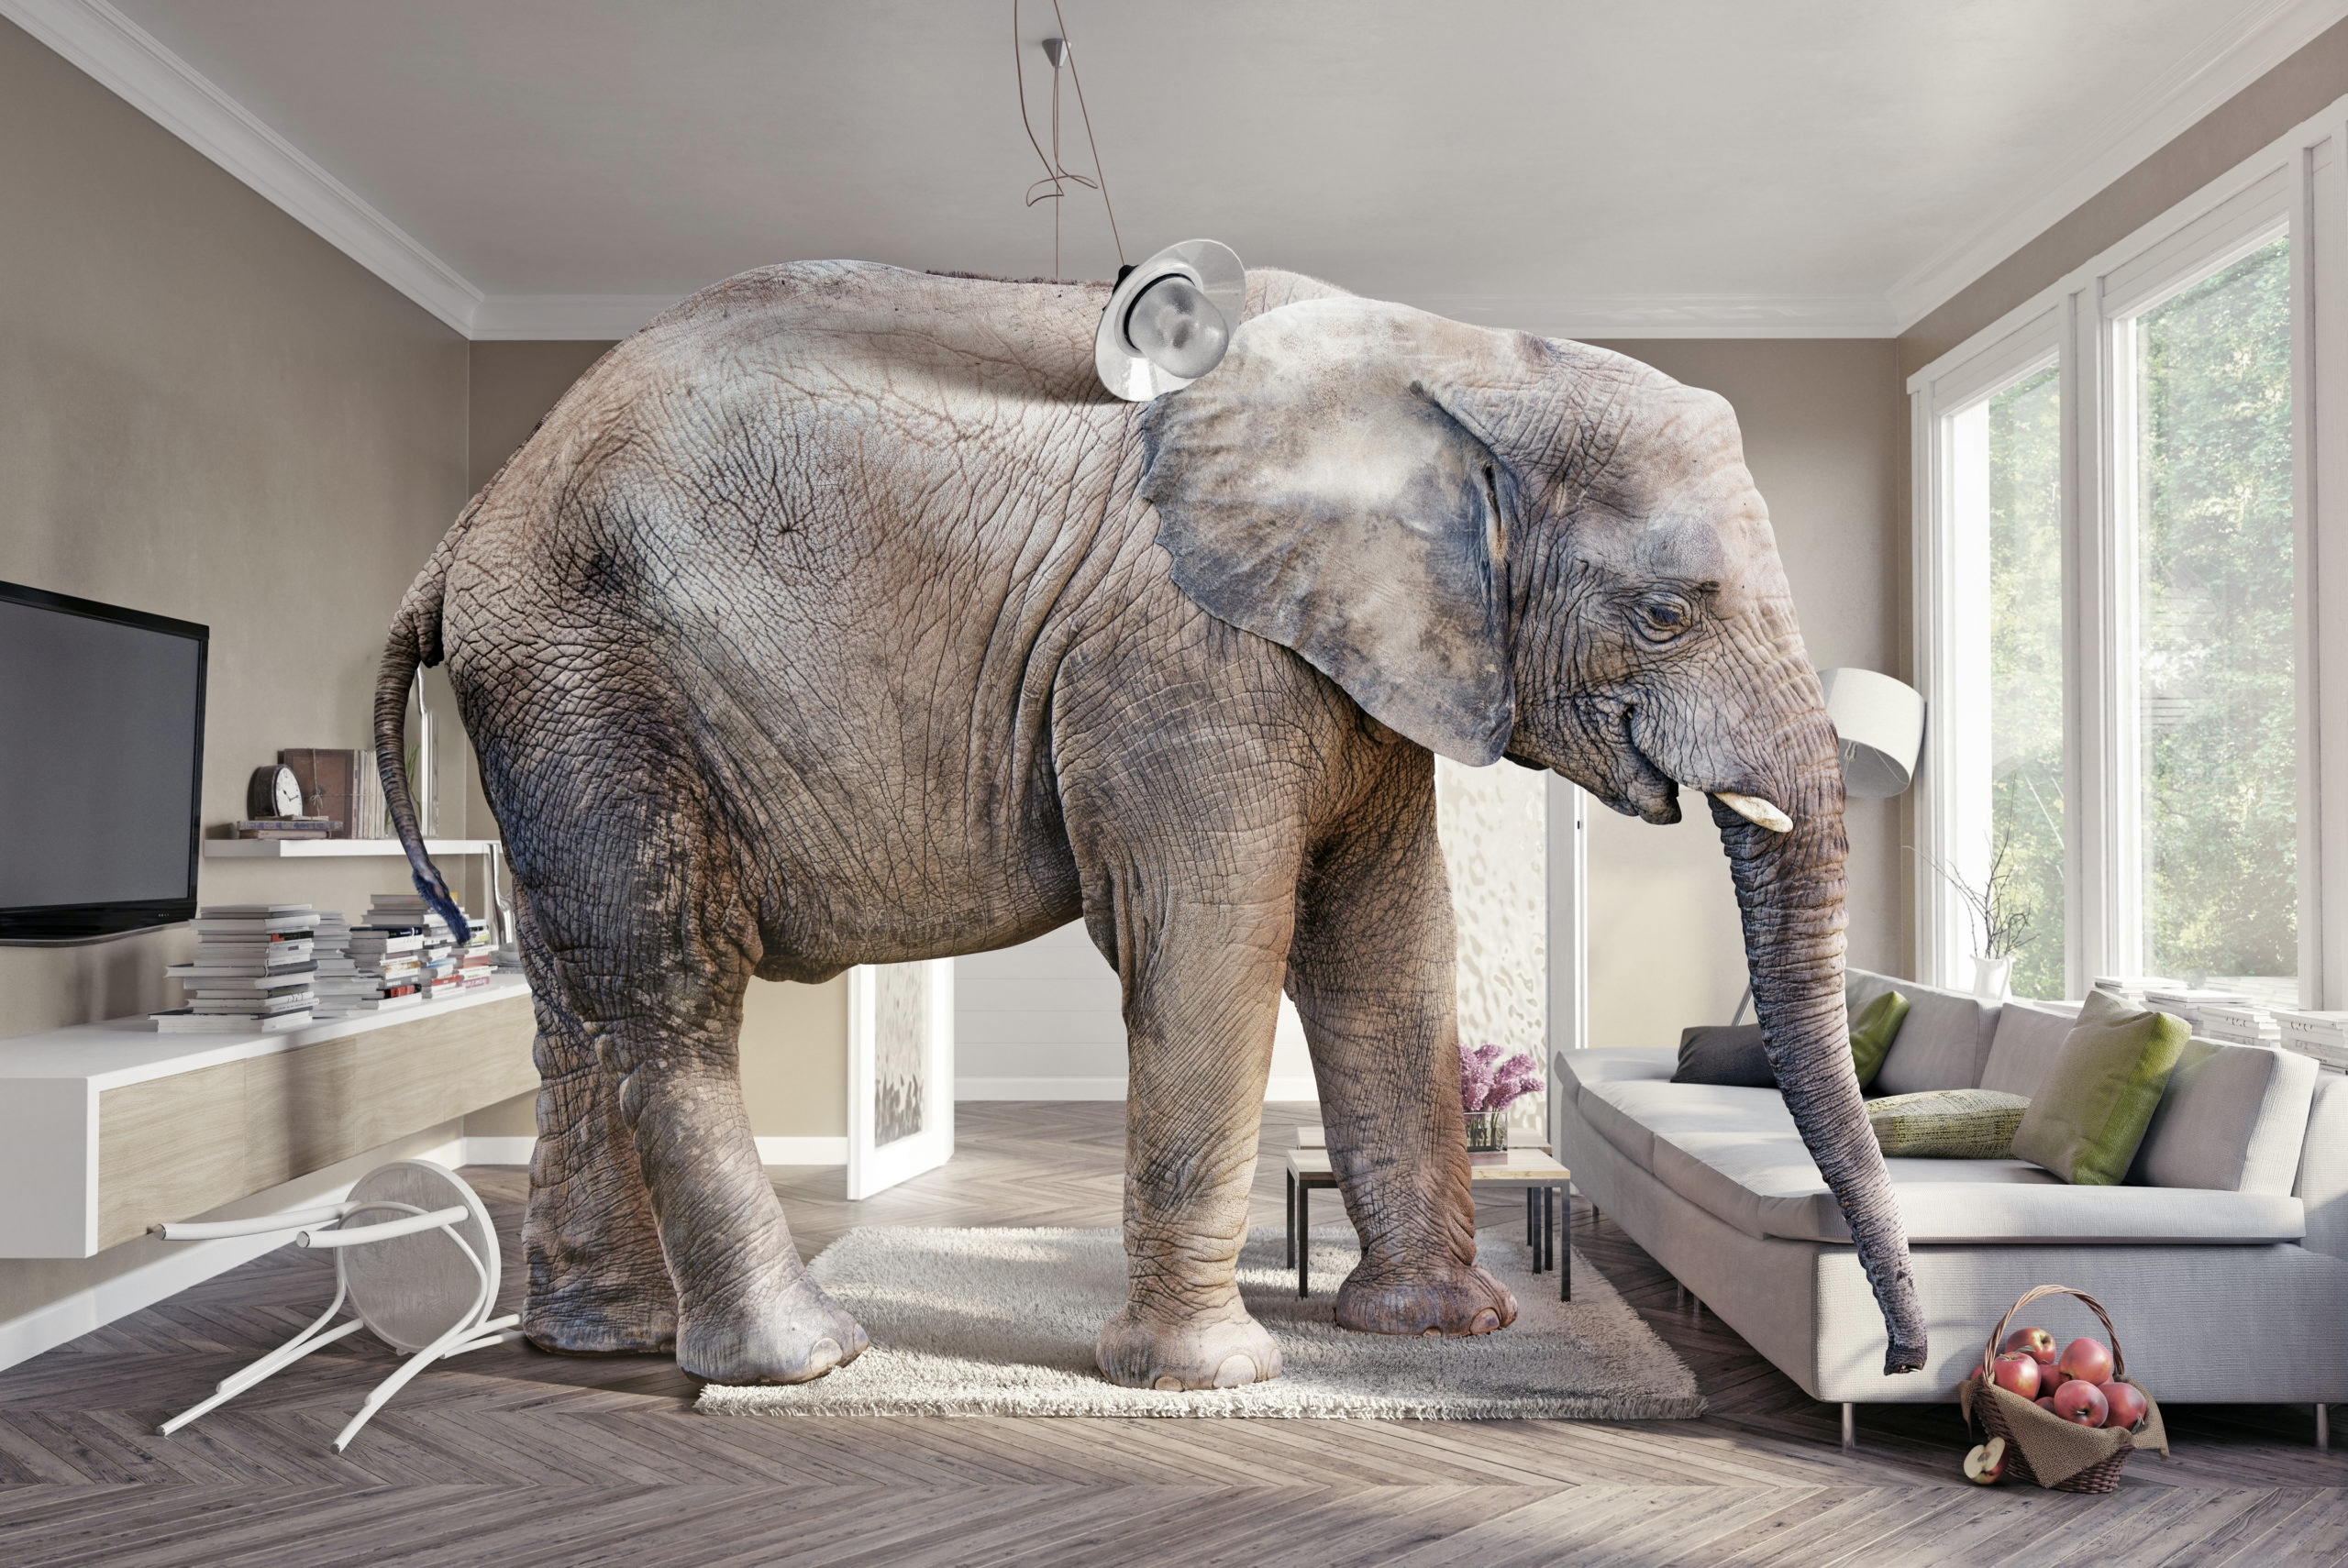

Elephant in the room
Notes:
And in general the Large Language Models.

Slide 14
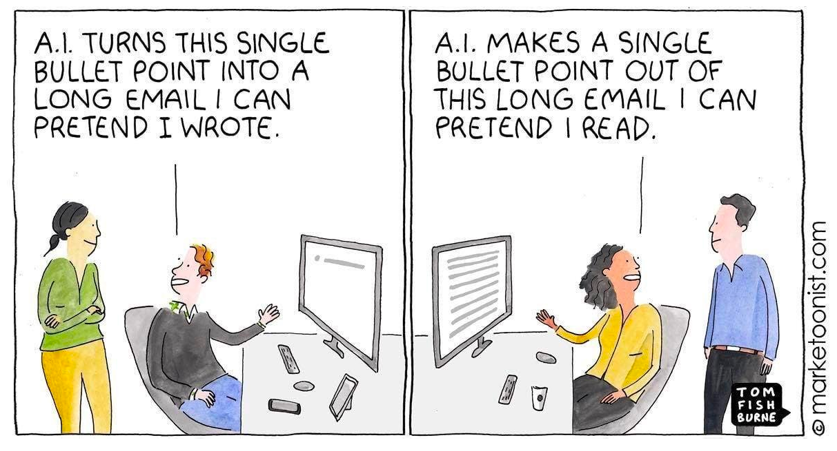
Chat GPT use case

Slide 15
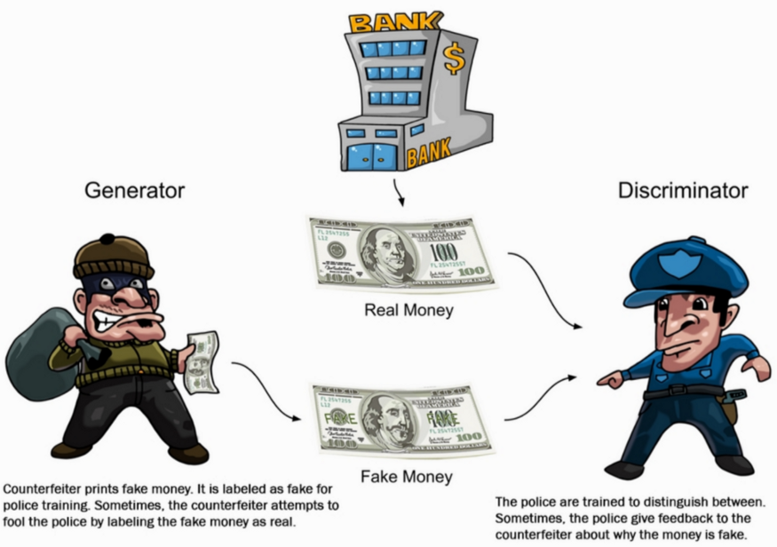
Generative mechanism

Slide 16

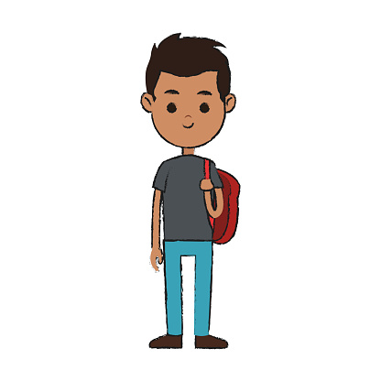



Possible scenario

Slide 17
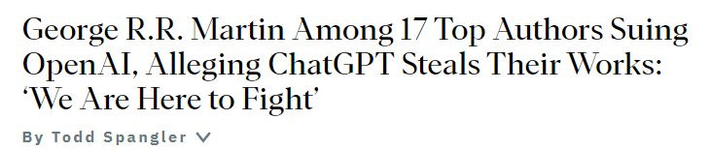
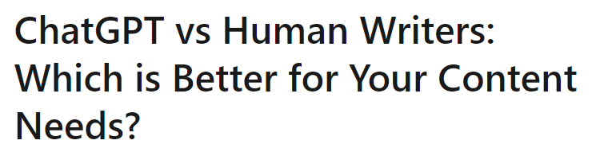
Different AI, same problem

Slide 18
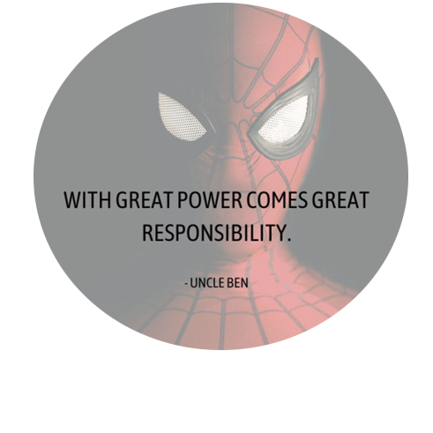
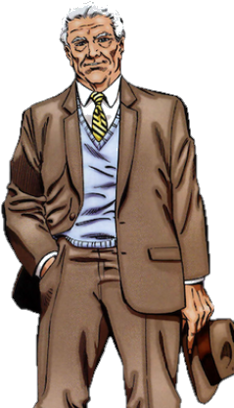
3 rules of technology
1: When you invent a new technology, you uncover a new class of responsibilities
2: If the tech confers power, it starts a race
3: If you do not coordinate, the race ends in tragedy

Slide 19




Social media
”Give everyone a voice”
”Connect with your friends”
”Join like-minded communities”
Is social media free?

Slide 20
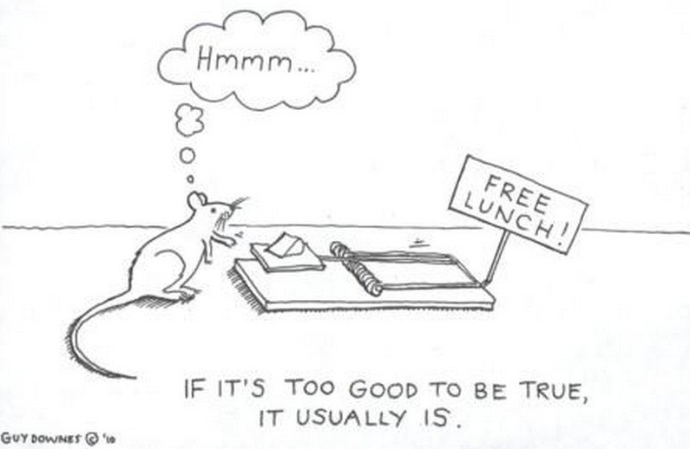
No free lunch
There is always a price.
If there is no price to pay, you are the price.

Slide 21

Data driven word
Notes:
Instagram, dumd scrolling
Recommender systems based on time.
Canceling a not wanted content takes more time – you will get more of it.

Slide 22
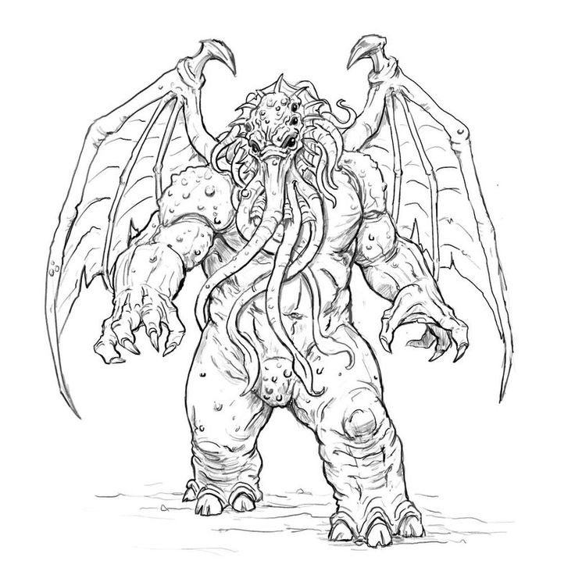
First contact with AI – Social media
Engagement maximalization
Information Overload
Addiction
Doomscrolling
Influencer Culture
Sexualization
Shortened attention spans
Polarization
Bots, DeepFakes
Fake news

Slide 23
Engagement maximalization
GDP
Elections
Politics
National security
Reaching
Customers
Media and Journalism

Slide 24
Second contact with AI – Generative AI
AI fields before
2017
AI fields after
Computer Vision
Speech recognition
Robotics
Music Generation
Speech Synthesis
Image generation
Language processing
Generative Large Language Multi-modal Modell
GLLMM
Transformer model

Slide 25
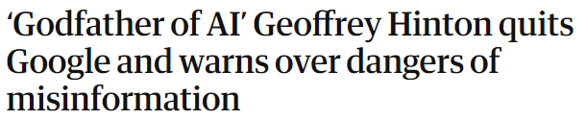
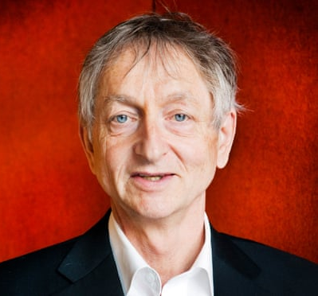

Godfather of AI
Dr. Geoffrey Hinton
“I console myself with the normal excuse: If I hadn’t done it, somebody else would have.”
Notes:
Warning sign
We are on uncharted therritory here.

Slide 26
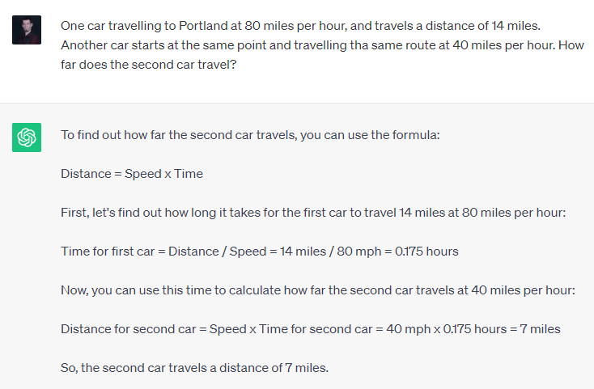
Chat GPT mistake
Notes:
Einstein riddle

Slide 27
Optional Homework #2 (10 points)
Chat with Chat GPT
Find a mistake and document it.
Link: https://chat.openai.com/auth/login

Slide 28
Thank you for your attention!

